Slide 1



Superstore Data Analysis
View in Power BI
Last data refresh:
1/15/2025 9:58:34 PM UTC
Downloaded at:
1/15/2025 10:01:51 PM UTC

Slide 2
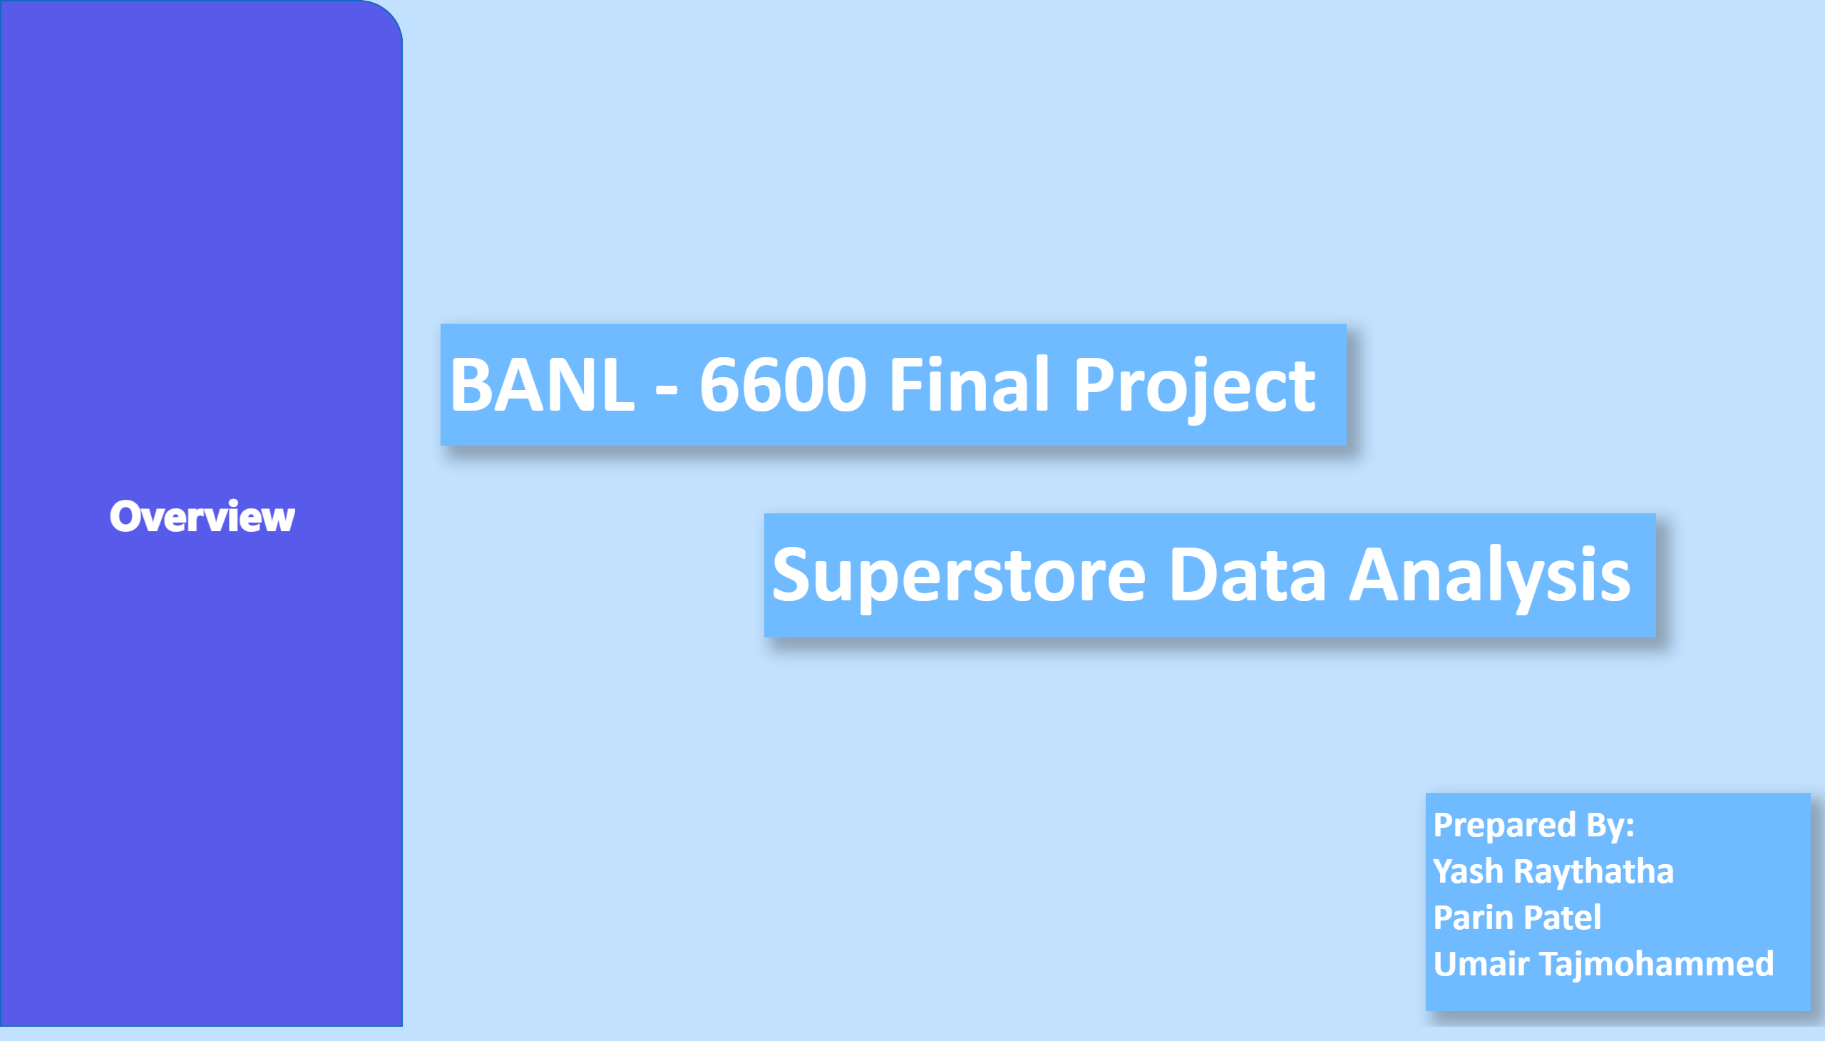

Introduction
Notes:
shape
No alt text provided
actionButton
No alt text provided
textbox
No alt text provided
textbox
No alt text provided
textbox
No alt text provided

Slide 3
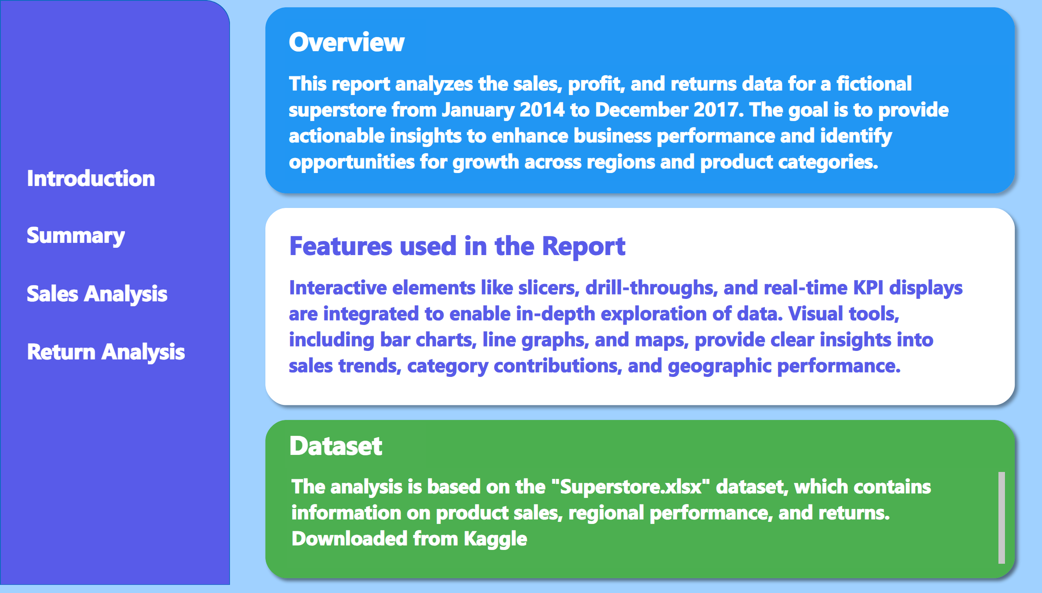
Overview
Notes:
shape
No alt text provided
actionButton
No alt text provided
actionButton
No alt text provided
actionButton
No alt text provided
actionButton
No alt text provided
shape
No alt text provided
shape
No alt text provided
shape
No alt text provided
textbox
No alt text provided
textbox
No alt text provided
textbox
No alt text provided
textbox
No alt text provided
textbox
No alt text provided
textbox
No alt text provided

Slide 4
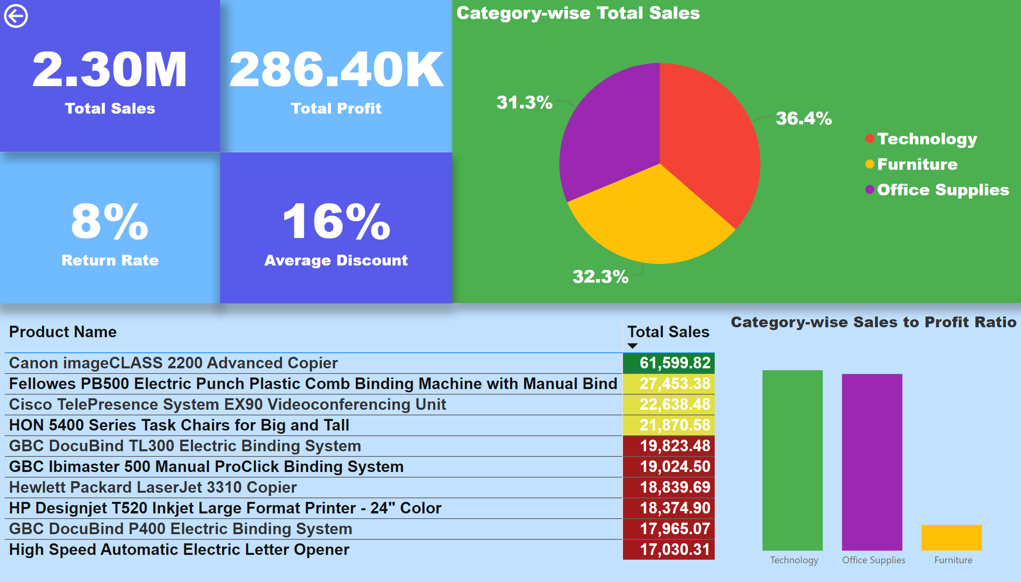
Summary
Notes:
card
No alt text provided
card
No alt text provided
card
No alt text provided
Category-wise Total Sales
No alt text provided
tableEx
No alt text provided
Category-wise Sales to Profit Ratio
No alt text provided
card
No alt text provided
actionButton
No alt text provided

Slide 5
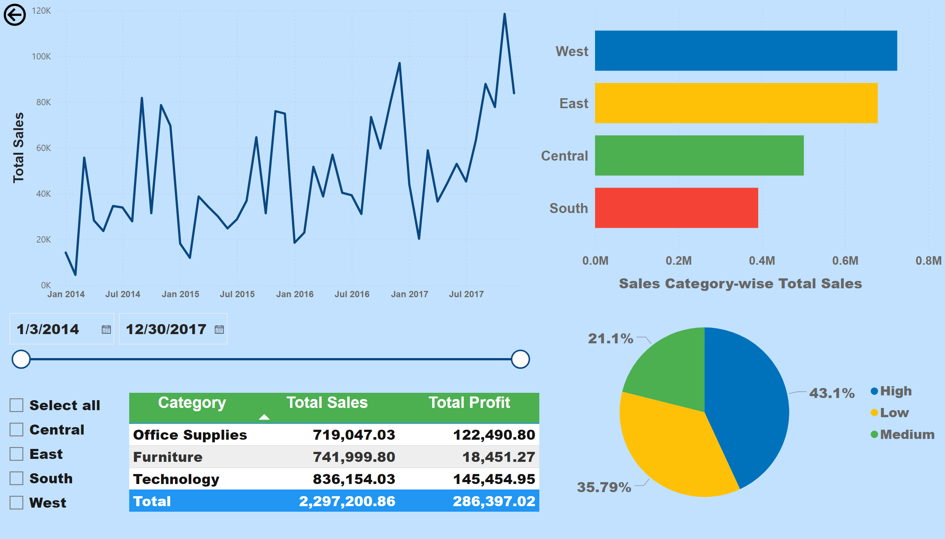
Sales Analysis
Notes:
barChart
No alt text provided
lineChart
No alt text provided
tableEx
No alt text provided
slicer
No alt text provided
slicer
No alt text provided
Sales Category-wise Total Sales
No alt text provided
actionButton
No alt text provided

Slide 6
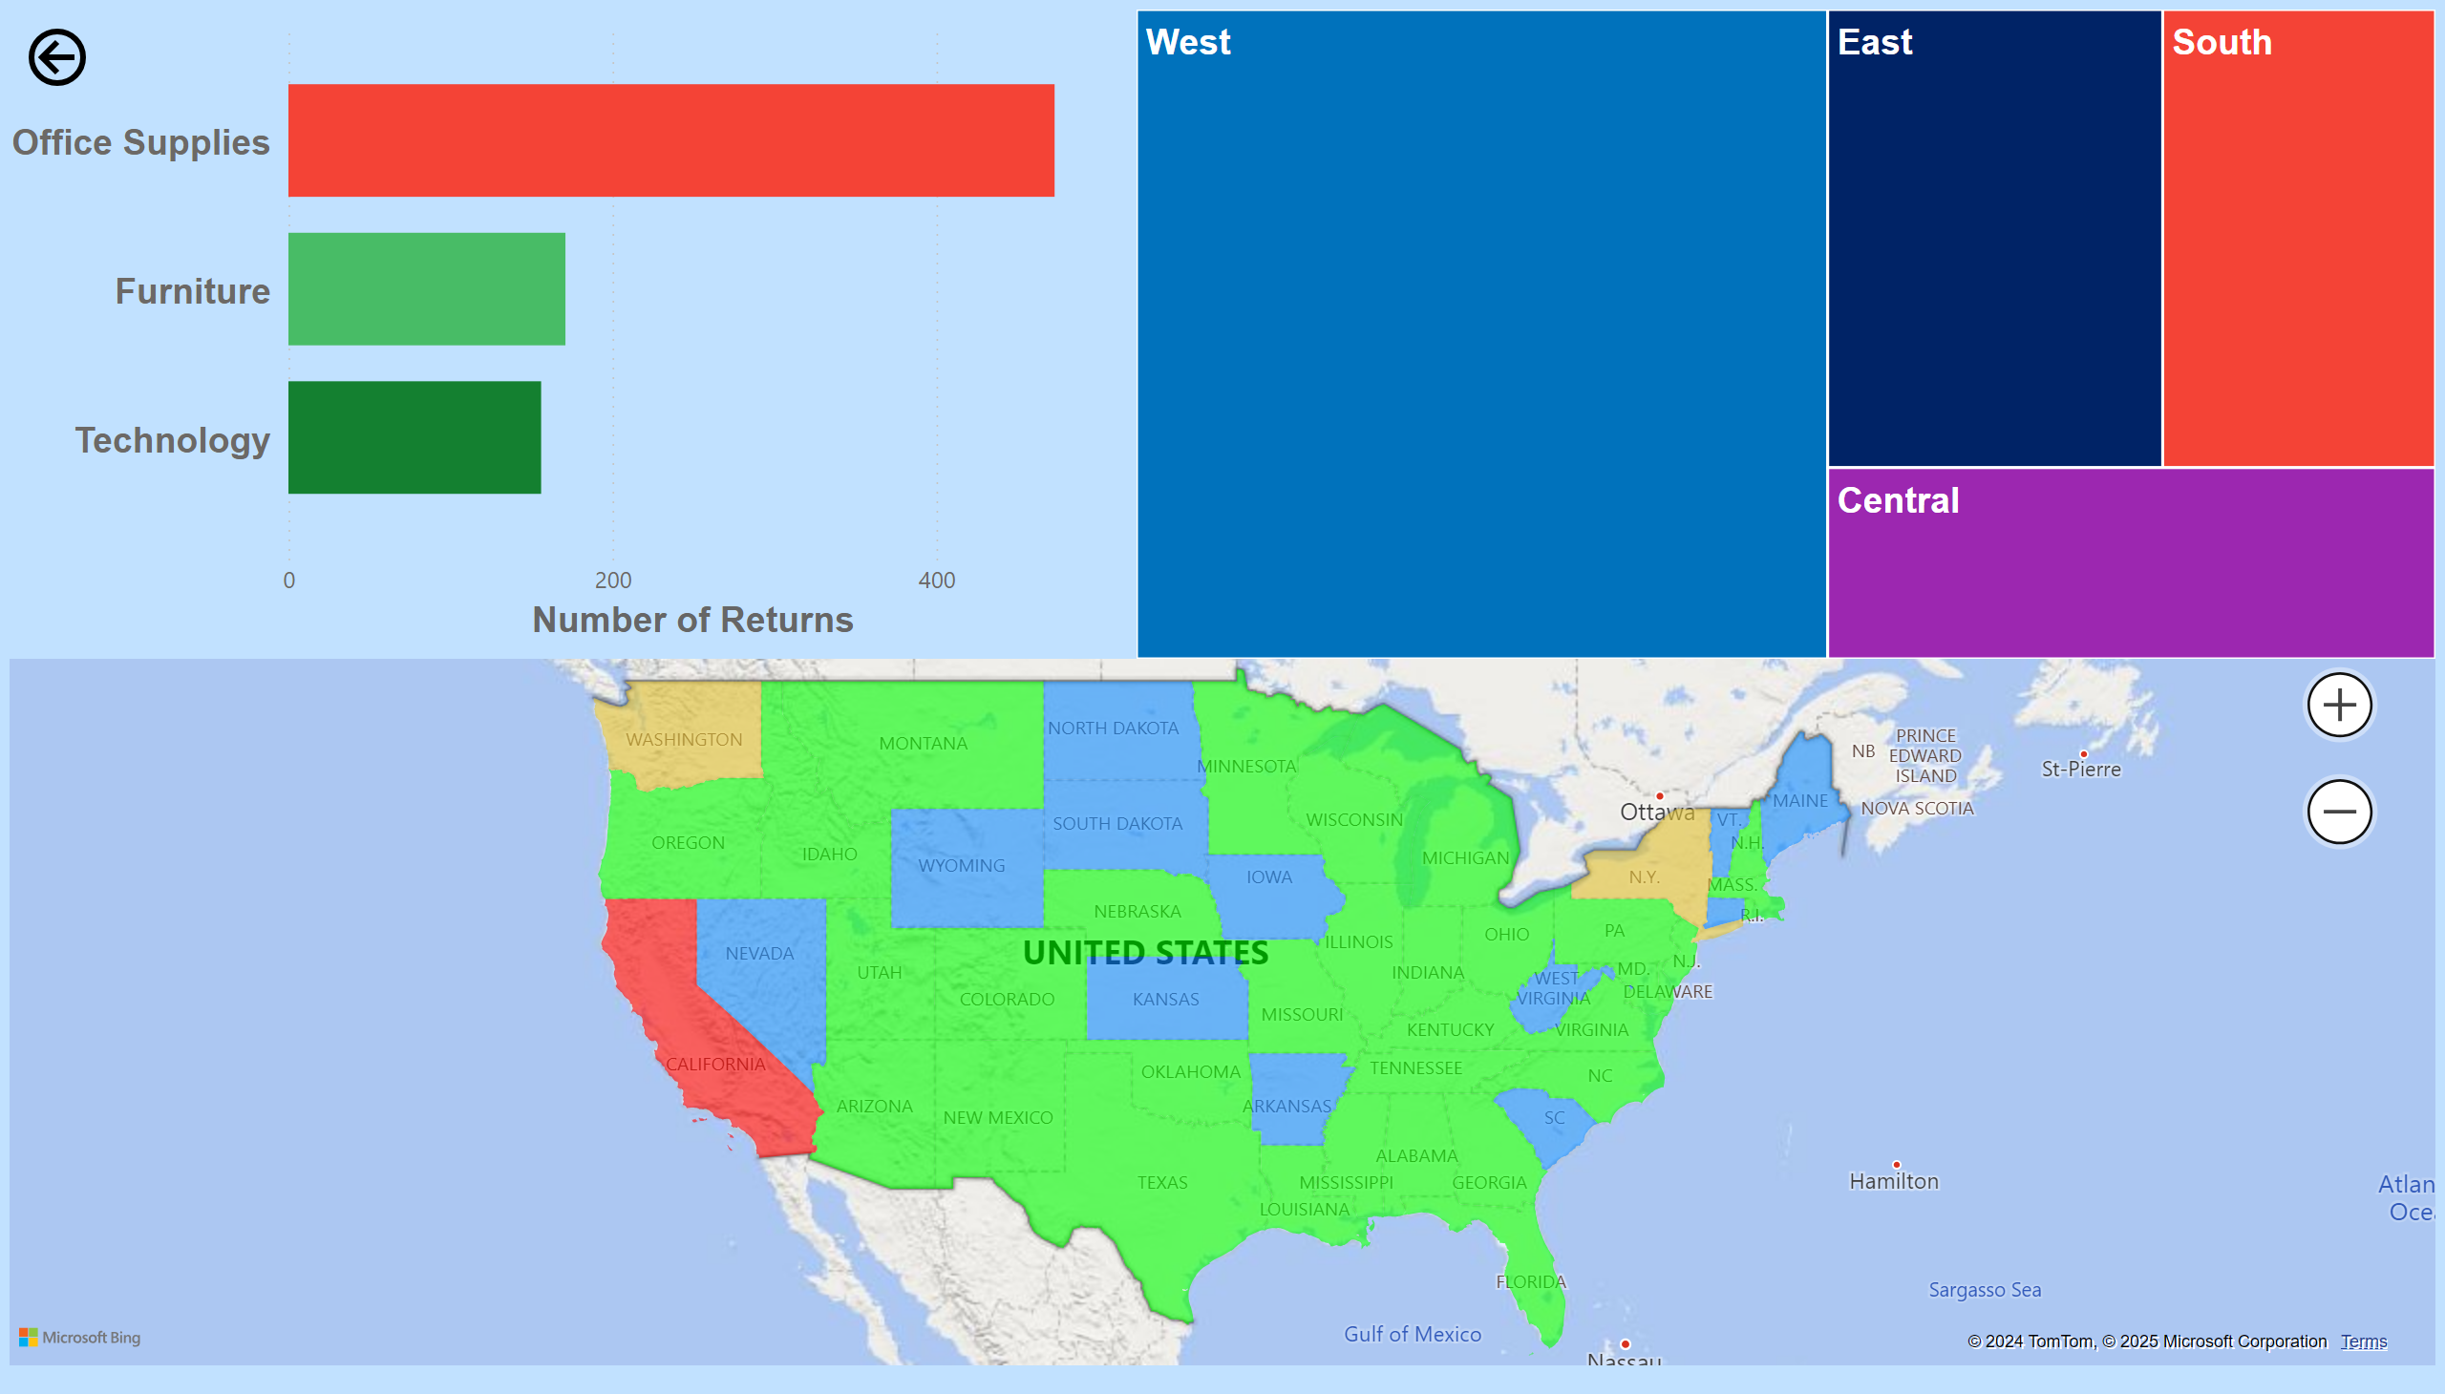
Return Analysis
Notes:
barChart
No alt text provided
treemap
No alt text provided
filledMap
No alt text provided
actionButton
No alt text provided

